Slide 1
Artificial Intelligence

Slide 2
Minimax Algorithms
The Minimax algorithm is a fundamental method used in decision-making for two-player.
It assumes that both players are rational and will make optimal moves.
The goal of the algorithm is to determine the best possible move for the player who is making the decision, considering that the opponent will also make optimal moves to minimize their loss.

Slide 3
Maximizing Player (Max): This is the player whose goal is to maximize their score. In a game like chess, this could be "White" or any player trying to win.
Minimizing Player (Min): This player tries to minimize the maximizing player's score. In chess, it could be the opponent, "Black.“
Game Tree: The decision tree representing all possible moves. The root node is the current state, and each edge represents a move.
Terminal States: These are the endpoints of the game e.g., win, loss, draw. The evaluation function is used to determine the score at these terminal nodes.

Slide 4
Algorithm
The algorithm uses recursion to explore the game tree and evaluates the best possible moves by considering all potential future game states.
Steps:
Generate the Game Tree: Starting from the current game state, generate all possible moves.
Evaluate Terminal States: For each terminal node (leaf node), assign a utility value (e.g., +1 for a win, -1 for a loss, and 0 for a draw).
Backpropagate the Evaluation:
Max Player: The Max player will always choose the move that leads to the highest utility.
Min Player: The Min player will always choose the move that leads to the lowest utility.
Choose the Optimal Move: Once the tree is evaluated, the best move for the current player (Max) is chosen based on the evaluation.

Slide 5
Alpha-Beta Pruning
Alpha-Beta Pruning is an optimization technique for the Minimax algorithm that dramatically improves its efficiency.
The primary goal of Alpha-Beta Pruning is to reduce the number of nodes the algorithm needs to evaluate in the game tree by "pruning" branches that cannot possibly affect the final decision.
This is done by keeping track of two values, Alpha and Beta, during the traversal of the game tree.

Slide 6
Alpha: The best value (highest) found so far along the path of the maximizer (Max player). It represents the best option the maximizing player can guarantee so far.
Beta: The best value (lowest) found so far along the path of the minimizer (Min player). It represents the best option the minimizing player can guarantee so far.
Alpha-Beta Pruning is used to stop the evaluation of branches that cannot influence the final decision, thus reducing the computation time of the Minimax algorithm.

Slide 7
Working Principle:
Initialization:
Alpha starts at -∞ (worst possible score for Max).
Beta starts at +∞ (worst possible score for Min).
Traversal:
As we traverse the game tree recursively:
Max Player tries to maximize the score, and thus updates Alpha with the highest value encountered.
Min Player tries to minimize the score, and thus updates Beta with the lowest value encountered

Slide 8
Pruning:
Prune the Max branch: If Beta ≤ Alpha, then no further exploration of the current node's siblings is needed (since the opponent will never allow the current node's value to be chosen).
Prune the Min branch: If Alpha ≥ Beta, no further exploration of the current node’s siblings is needed (since the opponent will never allow the current node’s value to be chosen).

Slide 9
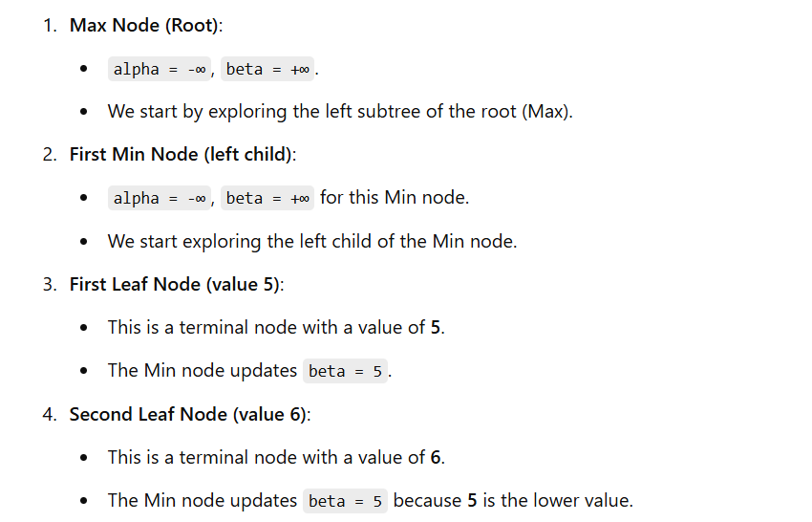
Steps:
Max
/ \
Min Min
/ \ / \
5 6 2 9

Slide 10
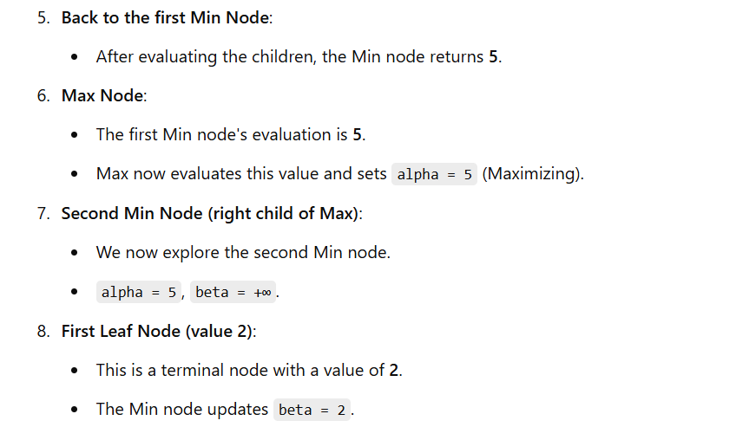
Max
/ \
Min Min
/ \ / \
5 6 2 9

Slide 11
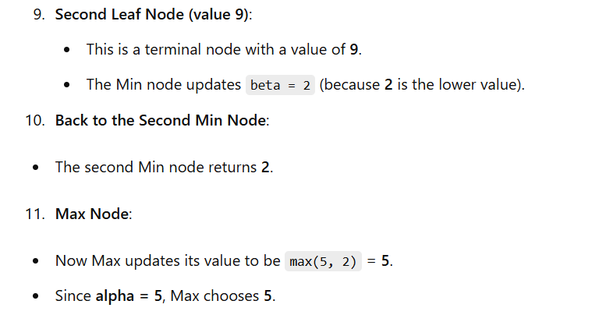
Max
/ \
Min Min
/ \ / \
5 6 2 9

